Slide 1
Cloud NAT
Cloud NAT provides network address translation (NAT) for outbound traffic to the internet, Virtual Private Cloud (VPC) networks, on-premises networks, and other cloud provider networks.
Cloud NAT provides NAT for the following Google Cloud resources:
Compute Engine virtual machine (VM) instances
Google Kubernetes Engine (GKE) clusters
Cloud Run instances through Serverless VPC Access or Direct VPC egress
Cloud Run functions instances through Serverless VPC Access
App Engine standard environment instances through Serverless VPC Access
Regional internet network endpoint groups (NEGs)
Using a NAT gateway, you can enable the following types of NAT:
Public NAT
Private NAT

Slide 2
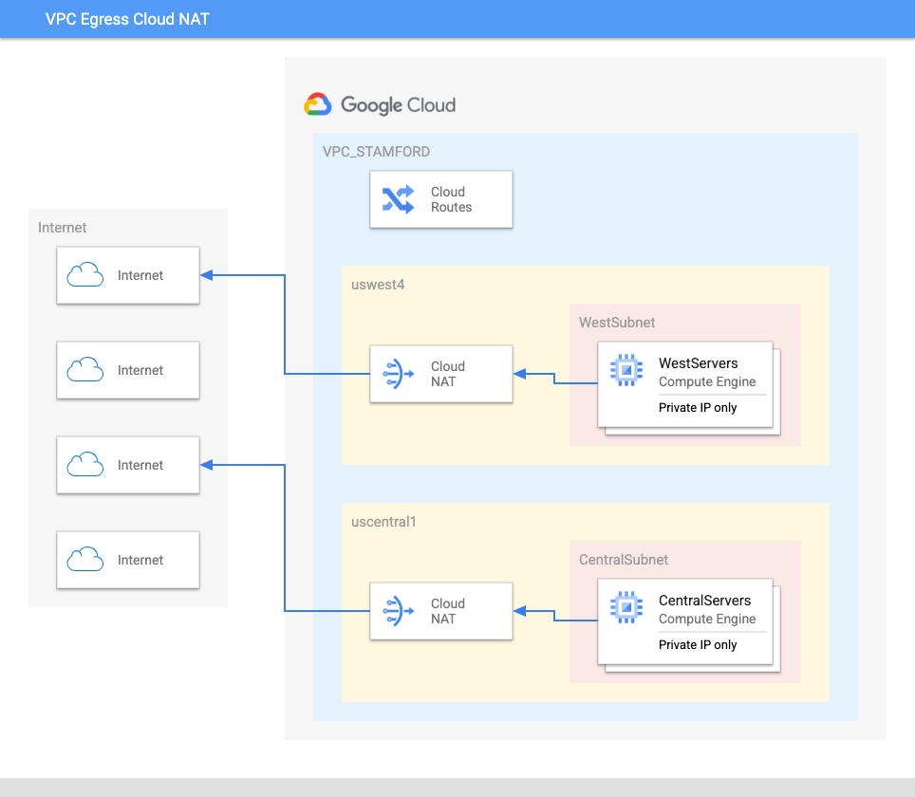
Public NAT
Public NAT lets Google Cloud resources that do not have public IP addresses communicate with the internet. These VMs use a set of shared public IP addresses to connect to the internet.
Public NAT does not rely on proxy VMs. Instead, a Public NAT gateway allocates a set of external IP addresses and source ports to each VM that uses the gateway to create outbound connections to the internet. Cloud NAT provides NAT for the following Google Cloud resources:

Slide 3
Public NAT
A Public NAT gateway can only use routes whose next hops are the default internet gateway.
A Public NAT gateway never performs NAT for traffic sent to the select external IP addresses for Google APIs and services.
Instead, Google Cloud automatically enables Private Google Access for a subnet IP address range when you configure a Public NAT gateway to apply to that subnet range, either primary or secondary.
To provide NAT for VMs in service projects that use a Shared VPC network, you must create Cloud NAT gateways in the host project.
A Cloud NAT gateway created in one VPC network cannot provide NAT to VMs in other VPC networks that are connected by using VPC Network Peering, even if the VMs in peered networks are in the same region as the gateway.

Slide 4
IP addresses
A Public NAT IP address is a regional external IP address that is routable on the internet.
Automatic NAT IP address allocation. When you select this method, or choose Google Cloud defaults, Public NAT automatically adds regional external IP addresses to your gateway based on the following:
The network tier that you select
The number of VMs that use the gateway
The number of ports that are reserved for each VM
Manual NAT IP address assignment. When you select this option, you create and manually assign static (reserved) regional external IP addresses to your Public NAT gateway. You can manually assign IP addresses either from Premium Tier, from Standard Tier, or from both, subject to conditions.

Slide 5
Ports
Each NAT IP address on a Cloud NAT gateway (both Public NAT and Private NAT) offers 64,512 TCP source ports and 64,512 UDP source ports. TCP and UDP each support 65,536 ports per IP address, but Cloud NAT doesn't use the first 1,024 well-known (privileged) ports.
Static port allocation: You specify a minimum number of ports per VM instance. If you don't specify the minimum number of ports per VM, Google Cloud uses the default value. Static port allocation is enabled, by default, for Public NAT. Because all VMs are allocated the same number of ports, static port allocation works best if all VMs have similar egress usage.
Dynamic port allocation: When you configure dynamic port allocation, you specify a minimum number of ports per VM instance and a maximum number of ports per VM instance. Configuring dynamic port allocation lets the same Cloud NAT gateway allocate different numbers of ports per VM, based on the VM's usage.

Slide 6
Limitations
If you change the network tier of the automatically allocated IP addresses for a Cloud NAT gateway, all connections on the old IP addresses immediately close.
If you use manual NAT IP address allocation, and you change the IP addresses that are used for Cloud NAT, all connections on the old IP addresses immediately close.
If you configure a Cloud NAT gateway with static port allocation, and you reduce the minimum ports per VM, established NAT connections might be broken.
If you configure a Cloud NAT gateway with dynamic port allocation, and you make any further configuration changes, established NAT connections might be broken.
If you configure a Cloud NAT gateway with dynamic port allocation and then turn off dynamic port allocation, all VM connections that use the NAT gateway are closed.
If Endpoint-Independent Mapping is turned on, you can't configure dynamic port allocation or NAT rules.

